Slide 1

19L702 - WIRELESS COMMUNICATION
5G
Handoffs using RL
PRESENTED BY,
21L414 - B SAKTHITHASAN
21L401 - R AKASH
20L151 - M N THARUN BALAJI
20L147 - R SURESHKUMAR

Slide 2
INTRODUCTION
Handoff, also known as handover, refers to the process of transferring an ongoing mobile communication session from one cell or base station to another without interruption.
Handoff is essential to maintain a continuous connection for a mobile user as they move through different coverage areas, such as when driving, walking, or using public transportation.
Handoff is particularly significant in 5G networks due to their key features, such as ultra-low latency, high data rates, and massive device connectivity. The seamless handoff process ensures that these features are maintained, offering users a consistent and reliable experience.

Slide 3
TYPES
There are 4 types of handoff procedures in 5g network. They are,
Intra-cell Handoff: It involves transferring a user within the same cell, often due to changes in signal quality or sector utilization. The user remains on the same frequency and cell but may be moved to a different sector within that cell.
Inter-cell Handoff: It happens when a user transitions from one cell to another cell, often due to moving out of the coverage range of the current cell or due to a stronger signal in the neighboring cell.

Slide 4
TYPES
Inter-frequency Handoff: It is essential when 5G networks use multiple frequency bands or carrier aggregation. Users need to switch between different frequency bands for optimized performance.
Inter-RAT Handoff: It occurs when a user moves from a 5G network to a different radio access technology, such as 4G LTE or 3G, to maintain connectivity when 5G coverage is not available.

Slide 5
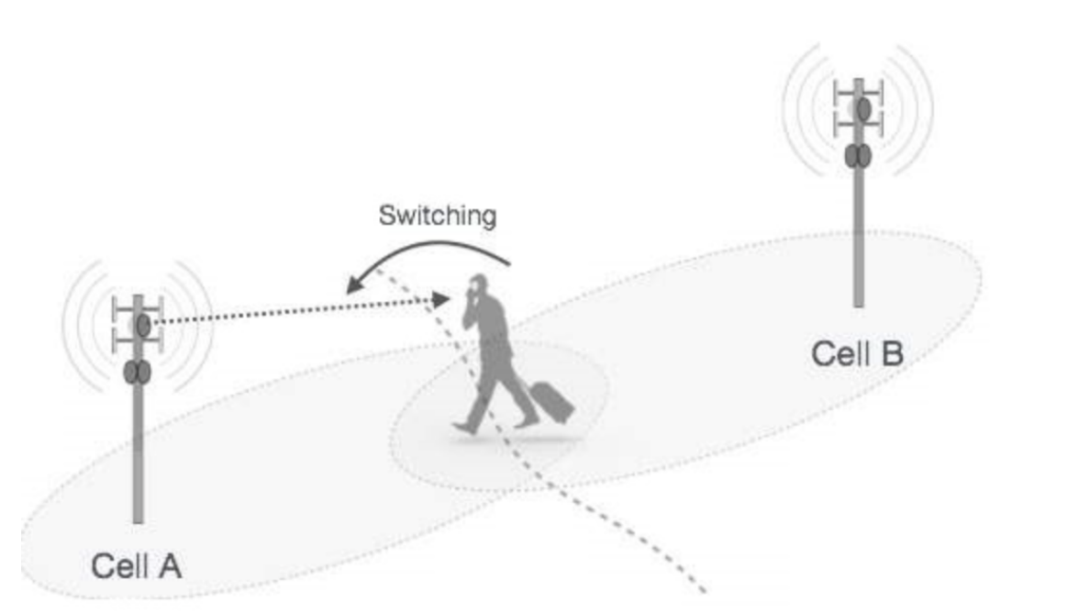
HANDOFF

Slide 6
PROCESS
Measurement and Monitoring:
Mobile devices continuously monitor the signal strength, signal quality, and other relevant parameters of the current cell and neighboring cells.
Measurements are performed to assess the quality of the connection and determine if a handoff is necessary.
Threshold Crossing:
When the measured parameters fall below or exceed predefined thresholds, it indicates that the current cell's quality has degraded or a neighboring cell offers a better signal.
Thresholds are set to trigger the handoff process when the signal quality is no longer suitable for maintaining a high-quality connection.

Slide 7
PROCESS
Handoff Decision:
The network evaluates the available cells based on the measurements and makes a decision to initiate a handoff.
Factors considered include signal strength, signal quality, cell load, and user priority.
Target Cell Selection:
The network selects the most suitable target cell to which the mobile device will be handed over.
The decision is made based on the measurements and other relevant data to ensure the best possible signal quality and user experience.

Slide 8
PROCESS
Handoff Execution:
The network sends instructions to the mobile device to switch its connection from the source cell to the selected target cell.
The mobile device tunes into the new cell's frequency and begins communicating with it.
Handoff Confirmation:
Both the mobile device and the target cell confirm the successful handoff.
This confirmation is essential to ensure that the mobile device is connected to the new cell and that data can continue to flow seamlessly.

Slide 9
PROCESS
Data Forwarding:
Once the handoff is confirmed, data sessions are rerouted from the source cell to the target cell.
This step ensures that user applications and services experience minimal disruption during the handoff.
Quality of Service (QoS) Management:
The network continues to monitor the connection in the target cell to ensure that the user experiences the expected quality of service.
It may perform dynamic adjustments and optimizations to maintain high-quality communication.

Slide 10
PROCESS
Ongoing Monitoring:
After the handoff, the mobile device continues to monitor the signal quality and other network parameters.
If conditions change or if a better target cell becomes available, the handoff process can be initiated again.
Fallback Mechanism:
In cases where the handoff is not successful or if the target cell's conditions deteriorate, a fallback mechanism may be triggered to return the mobile device to the source cell or find another suitable cell.

Slide 11
CHALLENGES IN 5G HANDOFF
Ultra-low Latency Requirements
High Mobility of Users
Dynamic Network Conditions

Slide 12
5G HANDOFF FEATURES
In 4G LTE networks, handovers are primarily hard handovers, which means that the device discontinues its connection with the source cell before establishing a connection with the target cell.
5G networks support both hard and soft handovers. Soft handovers enable devices to connect to multiple cells simultaneously, improving reliability and reducing interruptions.
In 5G, handover decision making is more intelligent. It considers various factors, including signal strength, signal quality, load on the cells, and the device's speed and direction. Machine learning, artificial intelligence, and reinforcement learning are used to optimize handover decisions.

Slide 13
5G HANDOFF FEATURES
5G handovers are designed to have lower latency compared to 4G. Soft handovers and ultra-reliable low-latency communication (URLLC) capabilities in 5G reduce the impact on latency during handovers.
5G operates in a wider range of frequency bands, including mmWave, mid-band, and low-band. The use of higher-frequency mmWave bands can enable faster handovers, as well as support for multiple connections simultaneously.
5G networks often employ massive multiple-input, multiple-output (MIMO) technology, which improves beamforming and spatial multiplexing. This enhances the performance of handovers in 5G networks.

Slide 14
5G HANDOFF USING RL
Since 4G networks have comparatively a larger signal radius, the handover from one node to another happens intermittently.
Unlike the Fourth-generation network, 5G wireless signals are transmitted through a large number of closely located gNodeBs.
So, after the deployment of pure standalone 5G networks, there will be a possibility of frequent inter gNodeB handovers (shifting from one gNodeB to another).
Handovers decrease performance and consume a lot of energy.
Now, we are aiming to optimize the number of handovers by using reinforcement learning.

Slide 15
5G HANDOFF USING RL
This being a real-time problem, we would not have a training data set to make the agent learn. Instead, the agent has to interact with the environment to collect information.
Therefore, we use reinforcement learning techniques to optimize the number of handovers which in turn maintains hassle-free connectivity with lesser number of overall handovers.
Handovers also cause the ping pong effect. It is the handover happening to and fro between two gNodeBs frequently when the user equipment is present in the range of two gNodeBs.
This problem is also addressed by optimising the handovers using reinforcement learning.

Slide 16
5G HANDOFF USING RL
We are creating a 3x6 grid world environment with multiple antennas close to each other.
The agent moves around randomly and learns about all the available antennas at each state.
We are using the famous Q-learning method of reinforcement learning to construct a Q table after performing 5000 iterations.
The antenna with the highest Q value should be chosen to optimize handovers.

Slide 17
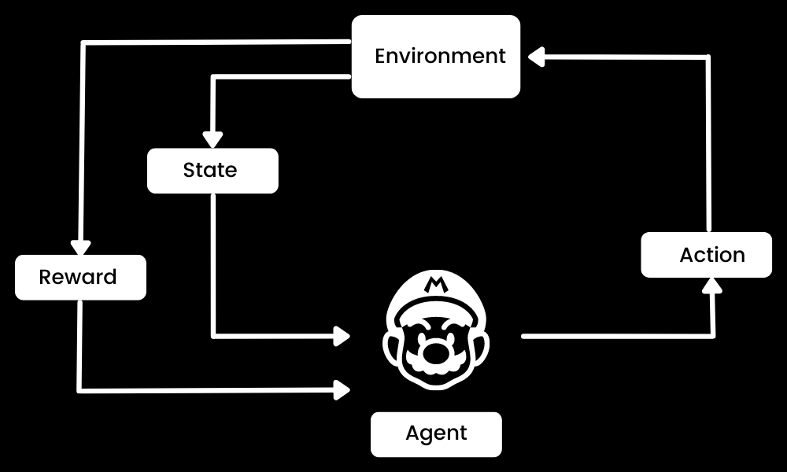
REINFORCEMENT LEARNING

Slide 18
Q-LEARNING
Q-learning is a model-free, value-based, off-policy algorithm that will find the best series of actions based on the agent's current state.
The “Q” stands for quality. Quality represents how valuable the action is in maximizing future rewards.
The model-based algorithms use transition and reward functions to estimate the optimal policy and create the model. In contrast, model-free algorithms learn the consequences of their actions through the experience without transition and reward function.

Slide 19
Q-LEARNING
The value-based method trains the value function to learn which state is more valuable and take action. On the other hand, policy-based methods train the policy directly to learn which action to take in a given state.
In the off-policy, the algorithm evaluates and updates a policy that differs from the policy used to take an action. Conversely, the on-policy algorithm evaluates and improves the same policy used to take an action.

Slide 20
Q-LEARNING
States(s): the current position of the agent in the environment.
Action(a): a step taken by the agent in a particular state.
Rewards: for every action, the agent receives a reward and penalty.
Episodes: the end of the stage, where agents can’t take new action. It happens when the agent has achieved the goal or failed.
Q(St+1, a): expected optimal Q-value of doing the action in a particular state.
Q(St, At): it is the current estimation of Q(St+1, a).
Q-Table: the agent maintains the Q-table of sets of states and actions.
Temporal Differences(TD): used to estimate the expected value of Q(St+1, a) by using the current state and action and previous state and action.

Slide 21
Q-TABLE AND Q-FUNCTION
Q-Table
The agent will use a Q-table to take the best possible action based on the expected reward for each state in the environment. In simple words, a Q-table is a data structure of sets of actions and states, and we use the Q-learning algorithm to update the values in the table.
Q-Function
The Q-function uses the Bellman equation and takes state(s) and action(a) as input. The equation simplifies the state values and state-action value calculation.

Slide 22
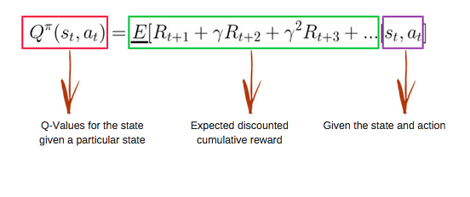
Q-FUNCTION

Slide 23
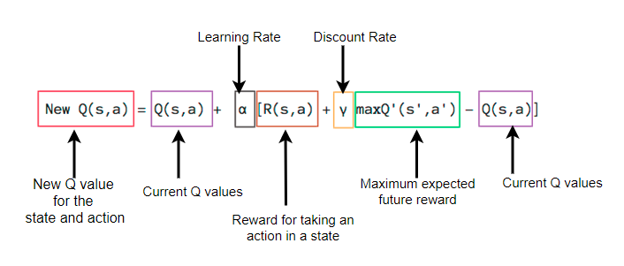
Q-FUNCTION

Slide 24
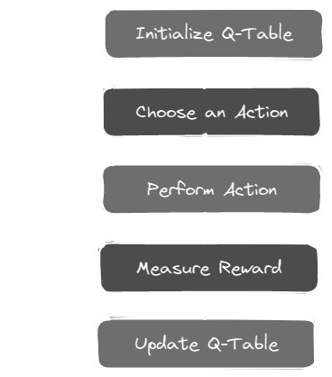
Q-LEARNING ALGORITHM

Slide 25
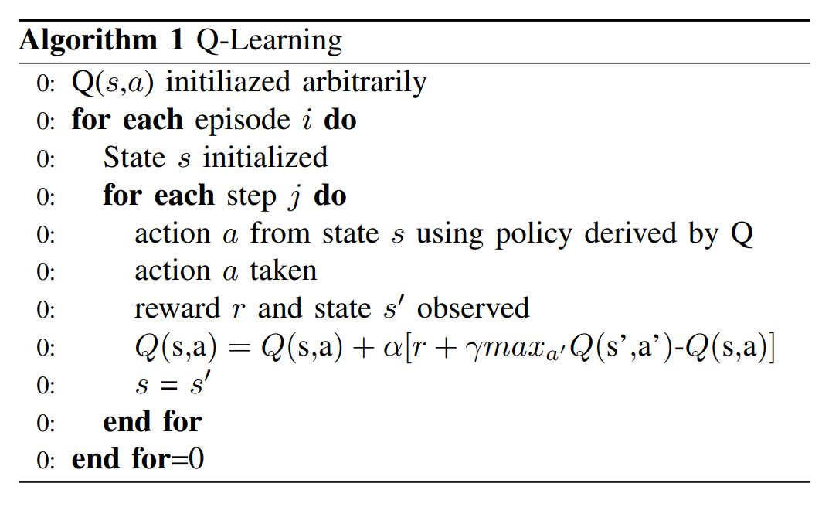
Q-LEARNING

Slide 26
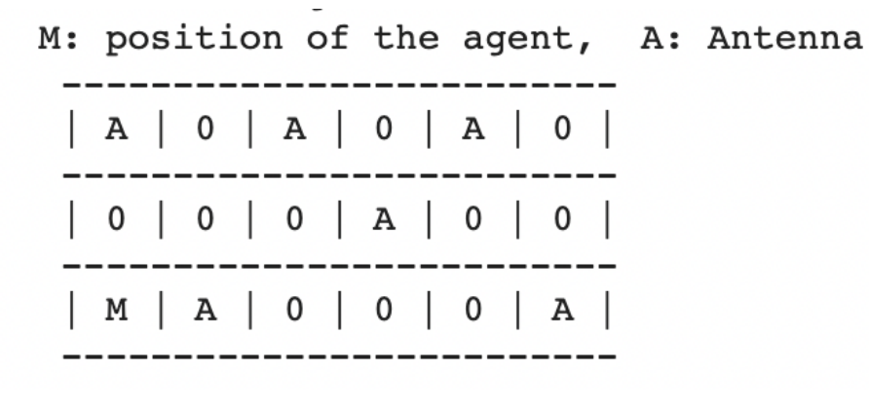
3x6 GRID
ENVIRONMENTAL MODEL GIVEN IN PAPER

Slide 27
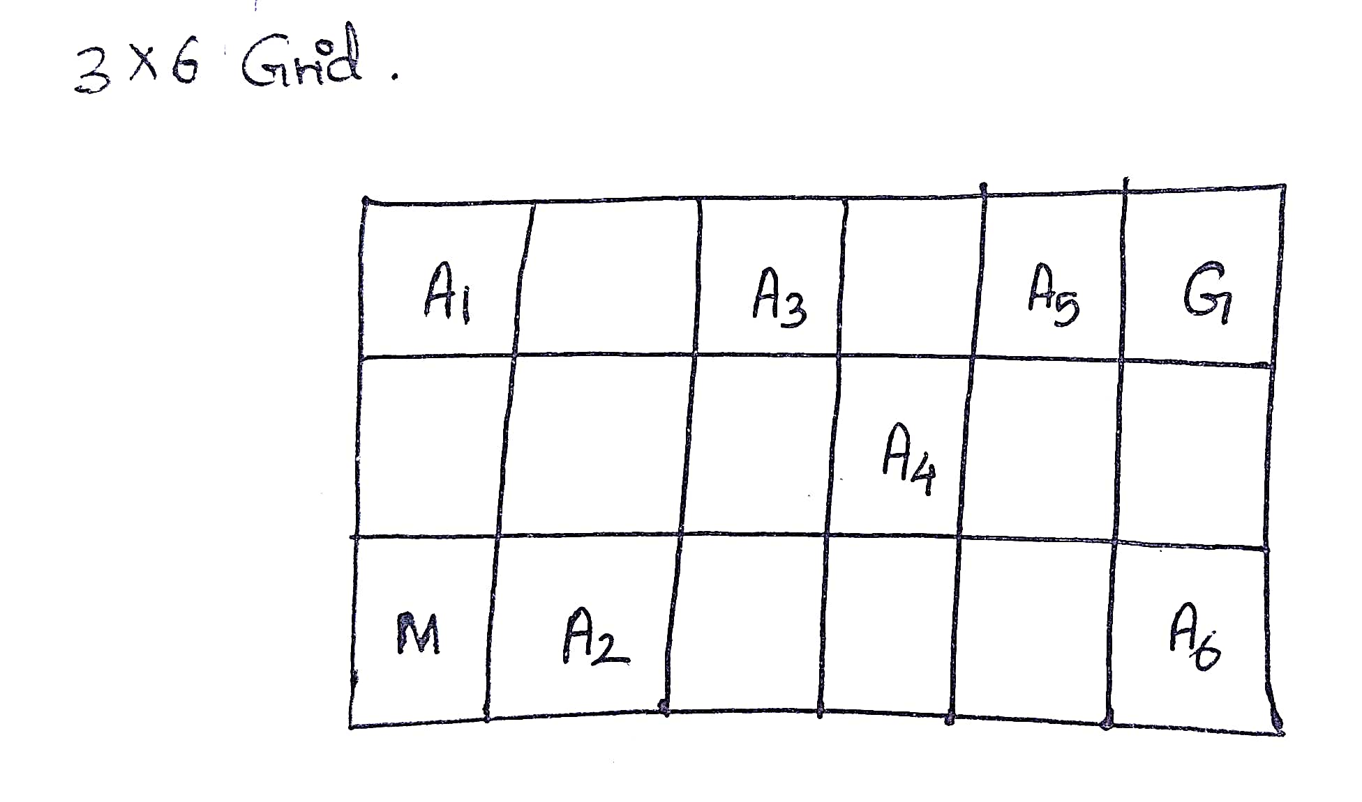
3x6 GRID
ANTENNA POSITIONS IN THE GRID

Slide 28
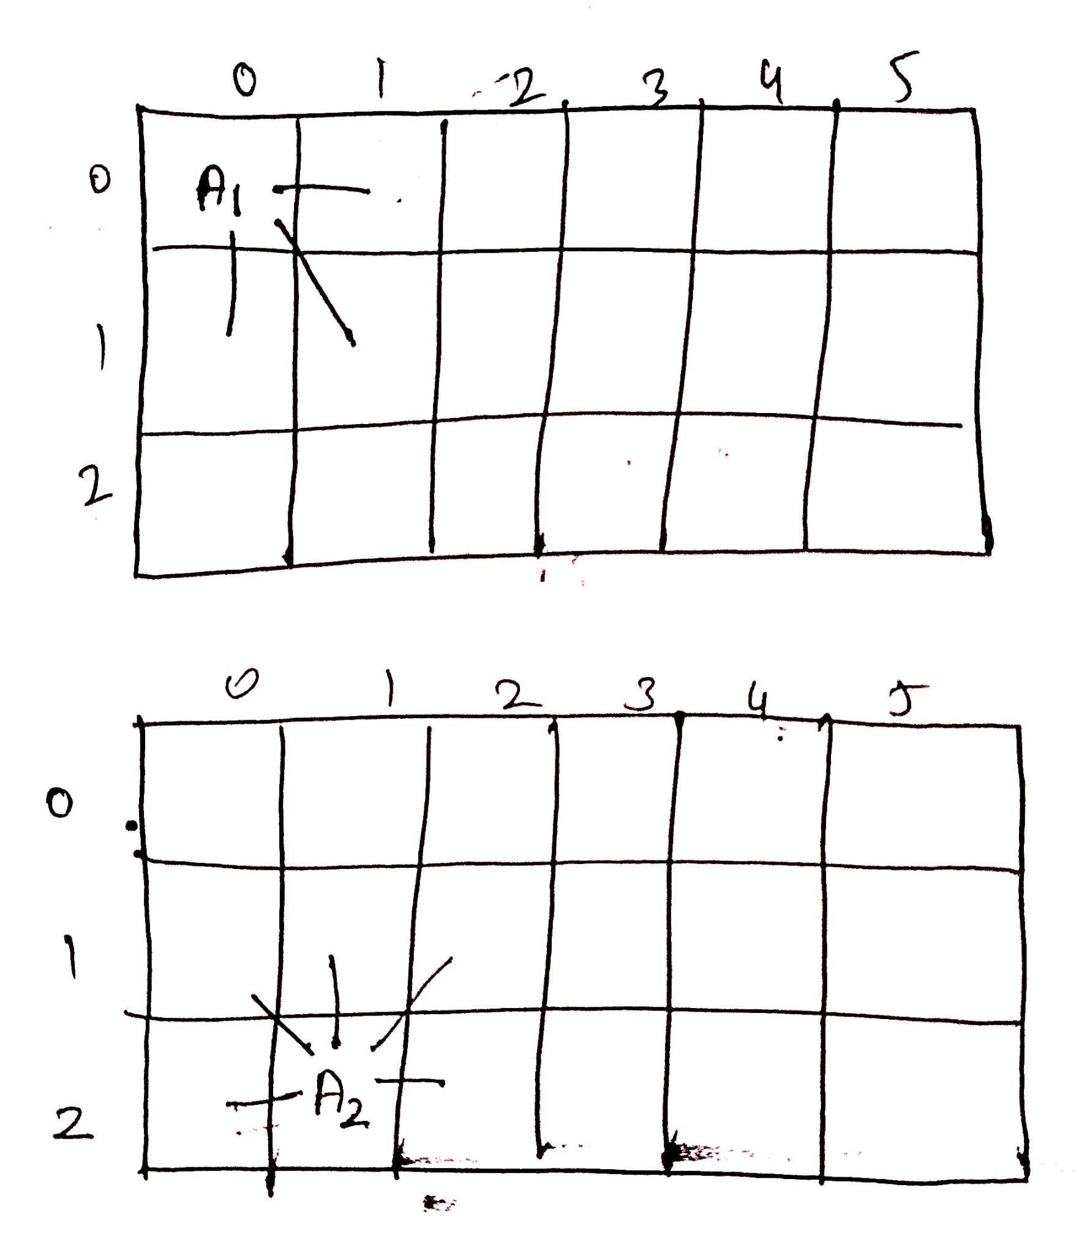
3x6 GRID
RANGE COVERED IN EACH ANTENNA

Slide 29
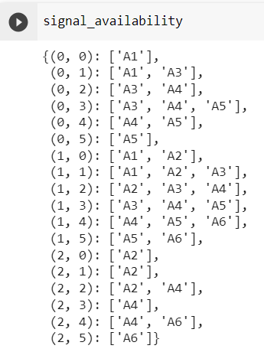
SIGNAL AVAILABILITY

Slide 30
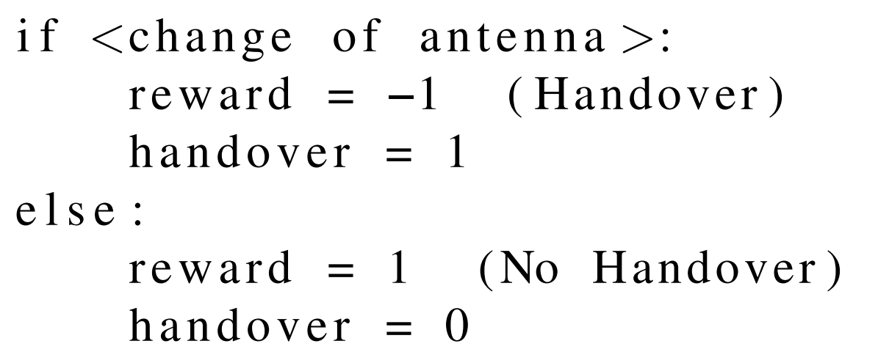
PARAMETERS
State space - coordinate points of the grid world
Action space - {right, left, up, down}
Reward:

Slide 31
PARAMETERS
Episodes - 5000
Timesteps per episode - 150
Epsilon - 0.82
Learning rate - 0.1
Discount factor - 0.95
Start position - (2,0)
Goal position - (0,5)

Slide 32
WORKING
The main idea is that the agent walks through the grid world moving from point A to point B.
While the agent performs a random walk and sees a lot of available gNodeBs to connect to. It has to connect to the best available gNodeB and keep moving towards the goal by having reduced number of handovers.
In the beginning, the epsilon rates will be higher. The agent will explore the environment and randomly choose actions. This occurs logically since the agent does not know anything about the environment.
As the agent explores the environment, the epsilon rate decreases and the agent starts to exploit the environment.

Slide 33
WORKING
We determine the signal availability for each coordinate in the grid first, and we assume that our antenna’s signal intensity is 1 in all directions, including the diagonals.
Because we’re using a random walk strategy, our agent starts at coordinate (2,0) and can do any action from our predetermined action space.
The agent must choose an antenna to connect to from its signal availability vector in addition to picking an action after each step.
When the agent takes a step, our goal is to optimize the antenna selection.
Q-table will be updated after each step using the Bellman equation based on the action taken by the agent

Slide 34
CODE EXPLANATION
Initialising antenna positions and range, start and goal position of the agent and action space.
In Environment class, reset(), step(), are defined. Next state and Reward is returned.
In Agent class, antenna selection is done through epsilon-greedy policy, action selection is done randomly, and reset() and q_update() are defined.
Hyperparameters are set by repeated tuning.
Then training starts by resetting environment and agent. Agent performs random walk in the environment.
According to action and antenna choosen by agent at each step, rewards are obtained and then agent tries to optimise its decision-making ability.

Slide 35
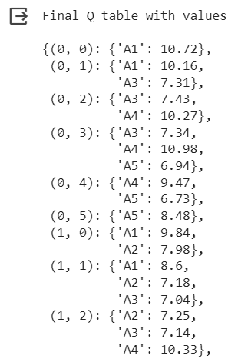
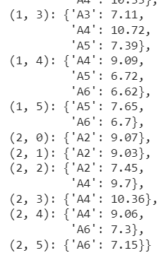
After Training,

Slide 36
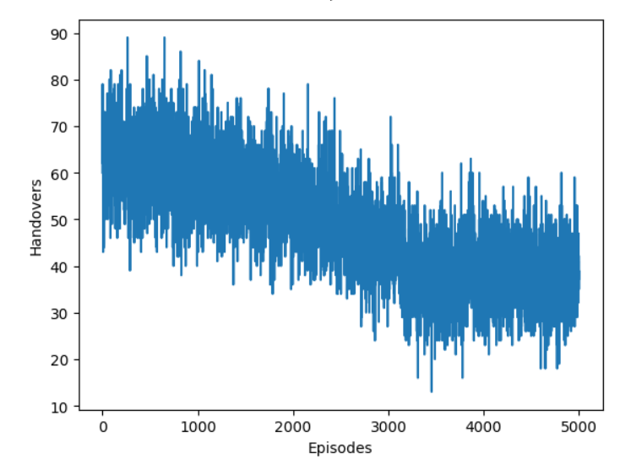
Episodes vs Handovers

Slide 37
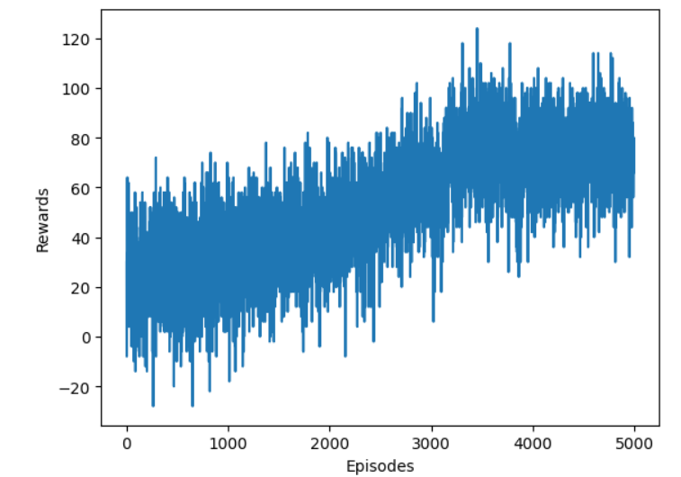
Episodes vs Rewards

Slide 38
CONCLUSION
Thus, we employed Q-Learning of reinforcement learning to minimize the number of handovers in a dense 5G network.
The number of episodes can be increased and also the epsilon value for choosing antennas can also be modified to make the algorithm more robust.
DynaQ learning can be applied instead of Q-Learning to make the model learn in fewer iterations.
This model can be deployed in the 5G enabled mobile phones of users to learn about the neighboring gNodeBs.

Slide 39
REFERENCES
BASE PAPER:
https://drive.google.com/file/d/1F_e6_DQMz2mRmAPaIoJefKd-0ZV8ZIae/view?usp=sharing
REFERENCE PAPERS:
https://drive.google.com/file/d/1c_i-rpPVyddknlyHIg94A_CGYbEBVzLb/view?usp=sharing
https://drive.google.com/file/d/1A-wdAxhK-g-Xz6QTPEPwJxKc2s49a753/view?usp=sharing
Q-LEARNING:
https://youtu.be/iKdlKYG78j4?si=heq1K7kS4DsPVF0k
https://www.datacamp.com/tutorial/introduction-q-learning-beginner-tutorial
https://github.com/gowtham-chandrasekaran/Handover-Optimisation-in-5G-using-Reinforcement-Learning
https://github.com/jpshlima/lstm-handover/tree/main#welcome-to-deep-learning-based-handover-prediction-for-5g-and-beyond-networks-repository

Slide 40
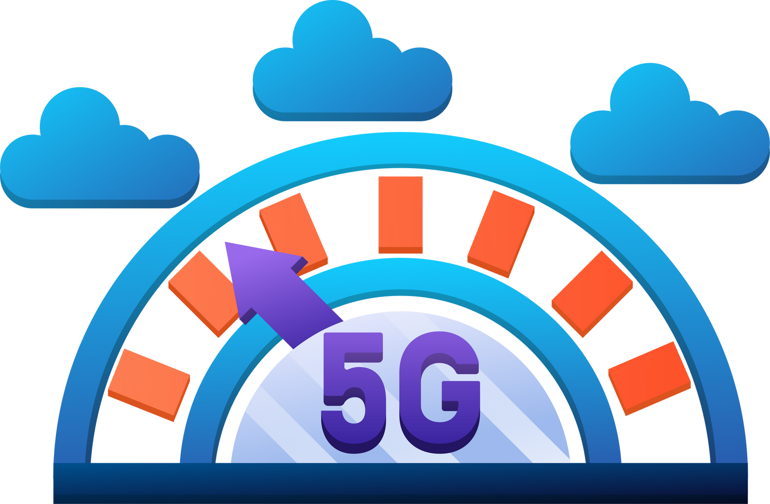
THANK YOU !

